Slide 1


Slide 2
WHY
DECENTRALIZED
CRYPTOCURRENCIES
ARE TRADE ON
CENTRALIZED
EXCHANGES?

Slide 3
DECENTRALIZED
=
CENTRALIZED

Slide 4
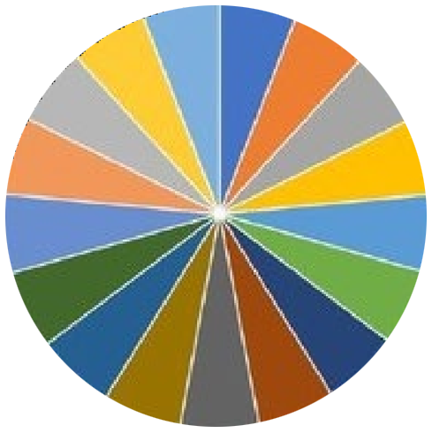
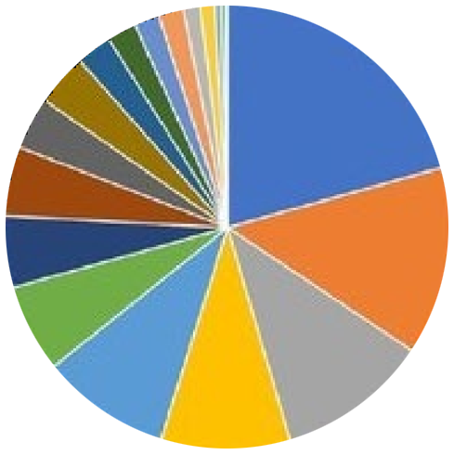
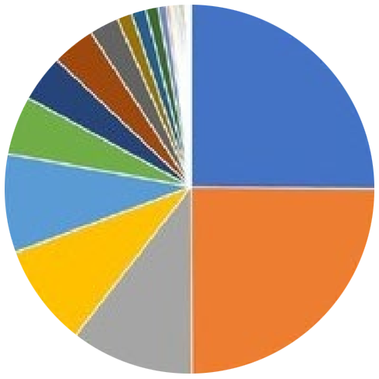
BITSHARES (DPOS)
BITCOIN (POW)
ETHEREUM (POW)

Slide 5


www.deex.exchange
Decentralized Crypto Exchange
BEST FROM CENTRALIZED EXCHANGES ON
DECENTRALIZED PLATFORM

Slide 6


USERFRIENDLY INTERFACE

Slide 7

FAST TRANSACTIONS

Slide 8
TOKEN TO TOKEN TRADING

Slide 9
MANY ALTCOINS

Slide 10

CROWDFUNDING PLATFORM

Slide 11


CRYPTO ATMS

Slide 12








BLOCKCHAIN INVESTMENT FUND

Slide 13
ETHEREUM ICO
$0,3 $870

Slide 14

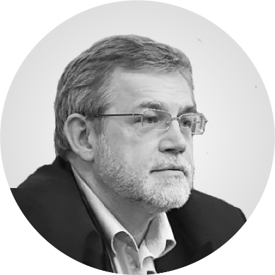
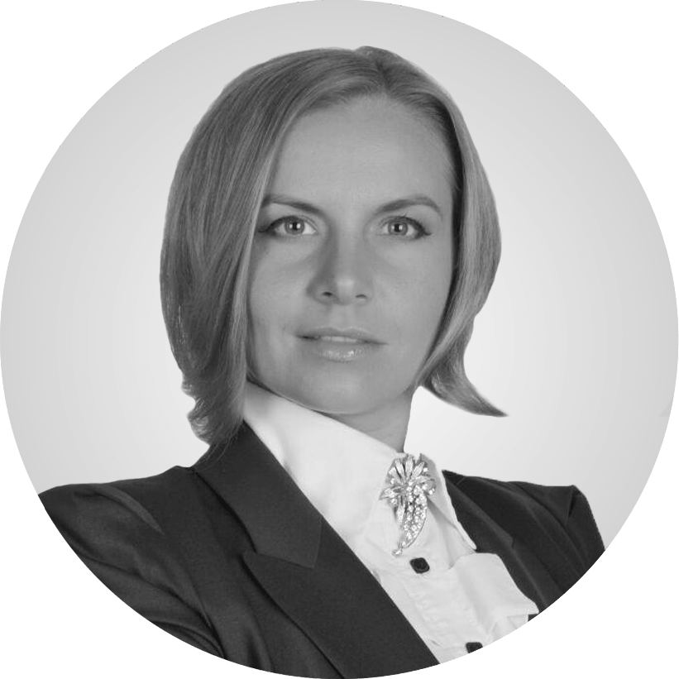


Vladislav Sapozhnikov
Yuri Milyukov
Maya
Zotova-Hess
Sergey Sevantsyan
Denis Soldatov

Slide 15
9 700+ ETH
DEEX ICO

Slide 16
About the company and speaker
Graduate of the Higher School of Economics and the LSE
Experience on the processing market since 2004
Sberbank, Alfa-Bank, CyberPlat, QIWI, FLEXSOFT Company
Predprocessing company works on the market since 2010. We work with banks, housing and communal services, payment systems
Blockchain applications development and consulting
Representative of COINSBANK Co-founder of the IBCG community

Slide 17









Slide 18
GIFTS
1. #1-20 T-shirt
2. #21-70 20% discount on purchasing 50 units Crypto ATM
3. #71-170 replenishment for 40 tokens
4. #171-240 replenishment for 45 tokens
5. #241-300 replenishment for 50 tokens

Slide 19

YOU CAN STILL BECOME
A PART OF DEEX
ICO ends
February 28th 2018
www.deex.exchange

